Slide 1
Internet
IGW
AWS Region 1(US)
AWS Region 2(US)
VPC 1
VPC 2
10.0.0.0/16
Router
10.5.0.0/16
Router
Public subnet
10.0.0.0/24
Elastic IP 18.189.241.187
Public subnet
10.5.0.0/24
Elastic IP 3.18.247.182
EC 2 Instance 1
EC 2 Instance 2
Containers running tasks
Containers running tasks
Containers running tasks
Containers running tasks
Private subnet
Private subnet
10.0.1.0/24
Communicating with RDS DB
RDS (MSSQL Instance)
10.5.1.0/24
Communicating with RDS DB
RDS (MSSQL Instance)

Slide 2
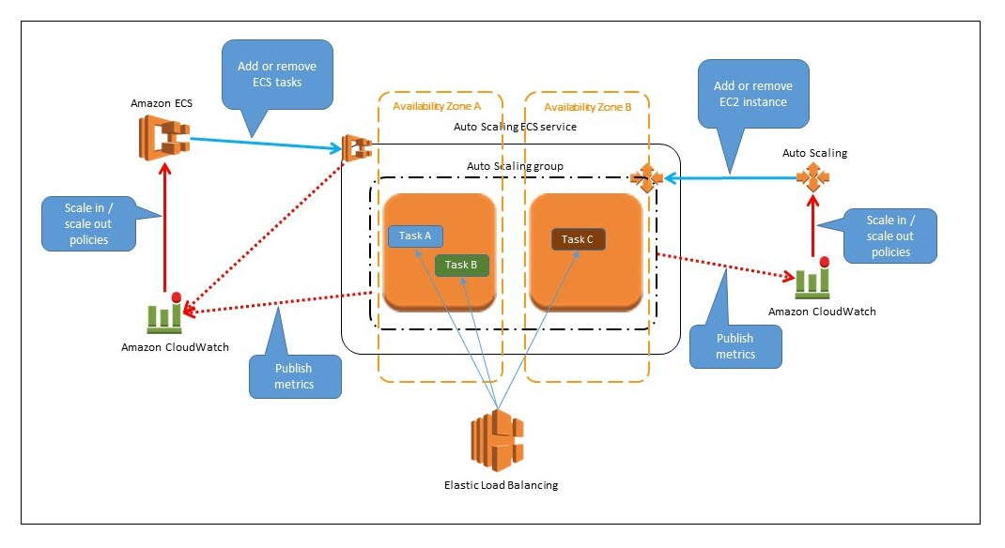
VPC 1
VPC 2
RDS
RDS
RDS
Private subnet
RDS (MSSQL Instance)
RDS

